Slide 1
Hi presenter! Read me before using!
This webinar resource is almost ready for you to use! Be sure to:
Look through and add custom information
Slide #2- Title slide (date)
Slide 3- Presenter information
Slide 5- Housekeeping items
Slide 22- Resources (optional)
Slide 23- Thank you slide
There are presenter notes to help guide you- feel free to edit these
This resource can be customized. Here are some examples of how you can personalize this slide deck to suit the needs of your educators and staff:
Replace our images with screen shots from your environment
Read through slides and ensure terms and jargon will resonate with your board policies/ tool names in your Brightspace environment (i.e. Assignments vs Dropbox, Announcements vs News)
Add additional information to slides specific to your district, including how this helps meet district goals, improvements plans, strategic plans etc
Include your district logo on slides or change the colors used to match your district branding

Slide 2
More Assessment and Feedback Options in Brightspace
<insert date>
© 2020 D2L Corporation
Notes:
This webinar will cover more options for assessment and feedback in Brightspace and focus on the Quizzes tool and the Discussions tool.

Slide 3
Presenter Name Title Company/Organization
@Twitter handle

Slide 4
Agenda
How to make a quiz with Brightspace’s Quizzes tool
How to use the Discussions tool
Sample use cases for the Discussions tool
Resources
Notes:
Our agenda today builds off our Introduction to Assessment and Feedback in Brightspace webinar held on __________. Today we’re continuing the assessment and feedback journey by looking at:
How to make a quiz with Brightspace’s Quizzes tool
How to use the Discussions tool
Sample use cases for the Discussions tool
Resources

Slide 5
Housekeeping Items
How can people ask questions?
Webinar recording and slide deck will be available on ___________
Information about attendance
Notes:
This slide is for you to add Housekeeping Items particular to your District and this session.
It may include information about how attendees can ask questions, how they can access the webinar information after the session, or even how they confirm their attendance for the session (if applicable)

Slide 6
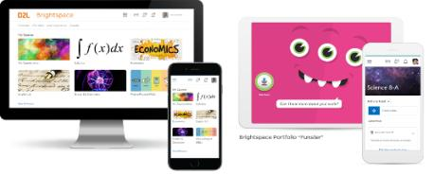
Understanding some terms...
Company:
D2L
Product:
Brightspace
Online Community:
Brightspace Community
Notes:
This is a useful slide to ensure everyone understand the terminology used when discussing Brightspace.
It would be helpful to personalize this slide to include any District specific information, especially if your District as a different branding for “Brightspace.” This will help attendees when they see resources about “Brightspace” to know that this is what your District is using as well but has branded differently.

Slide 7
Exceptional student experiences and outcomes
Equity for all students
Meaningful connections with parents
Why Educators
Brightspace
Tools teachers love
Worry-free technology
More partner, less vendor
Notes:
Here’s why customers love Brightspace

Slide 8
More Assessment and Feedback in Brightspace:
Quizzes tool
Discussions
Special Access and Release Conditions
Purpose:
Purpose:
Purpose:
Purpose:
Purpose:
Our Quizzes tool allows you to easily create quizzes for your students. There are several question types and options for feedback!
The Discussions tool is a collaboration area to post, read and engage on different topics or activities
Need to make some quizzes or discussion topics for some students? Have a few students who need more time on a quiz? Brightspace has options for that!
Notes:
Use this slide to introduce some of the tools or features you will discuss and cover during the demo
**Be sure to confirm the terminology on this slide matches the language terms used in your District’s Brightspace environment (i.e. Assignments vs Dropbox etc)

Slide 9
What is the Discussions tool?
The Discussions tool is a collaboration area to post, read and reply to threads on different topics or activities.
Forum
Topic
Thread
Notes:
The Discussions tool is a collaboration area to post, read and reply to threads on different topics, share thoughts about course materials, ask questions, share files or work with your peers on assignments and homework.
Before we head into a live demo, I want to cover some terminology you’ll hear me use when talking about discussions. I like to use a filing cabinet as an analogy
Forum is like the drawer of a filing cabinet. It’s organizes discussions and conversations of a broader subject, much like a filing cabinet drawer is used as the first layer of organization for files. For example, you might have a math forum or a creative writing forum.
Topics are like the file folders within a filing cabinet. All the topics show relate to the forum, but are more specific activities or areas that will house student answers within them. Much like a file folder will hold several documents that relate to the topic of that file folder. For example, within your Math forum, you might have a topic called Multiplication, Probability or Weekly Math Problems
Last we have threads and threads are similar to the individual documents you would find in the file folder, within the filing cabinet. Threads can be student work or responses, as well as you or other students commenting on other student’s threads. You can also think of this like an email thread chain.

Slide 10
Assessments and Feedback Demo
Learning Objectives:
You will be able to:
Create a Quiz
Use Special Access and Release Conditions on Quizzes
Create a Discussion Forum and Topic
Use Release Conditions on a Discussion Forum or Topic
Notes:
Next we’ll head into a live demo to show you more assessment and feedback options in Brightspace
Note: The learning objectives on this slide can be personalized to meet the needs for your District and attendees

Slide 11
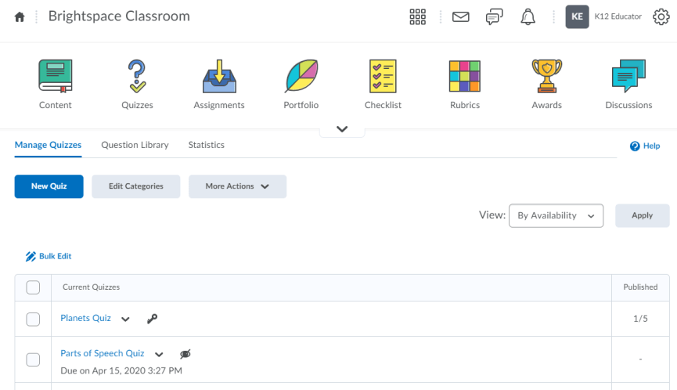
Create a Quiz (1/4)
1
2
Click Quizzes from your Navbar or Course Admin tool list
Click the blue “New Quiz” button.
Notes:
This slide can serve as a resource for your educators & staff after the webinar. It can also serve to help with step by steps instructions if doing a live demo is not possible.
Another option is to let your attendees know these how-to slides are in the slide deck for them to reference, and hide the remaining slides during the live webinar, and unhide them prior to send the slide deck to your attendees after the webinar.

Slide 12
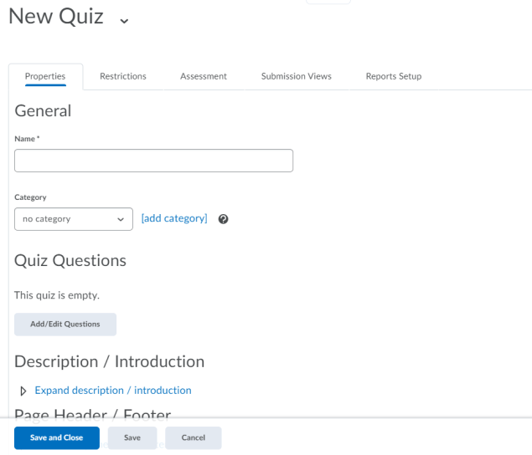
Create a Quiz (2/4)
Use Restrictions to add Release Conditions or Special Access for certain students
Give your Quiz a name and a category, if applicable
Click “Add/Edit Questions” to begin building your Quiz!
1
2
Notes:
This slide can serve as a resource for your educators & staff after the webinar. It can also serve to help with step by steps instructions if doing a live demo is not possible.
Another option is to let your attendees know these how-to slides are in the slide deck for them to reference, and hide the remaining slides during the live webinar, and unhide them prior to send the slide deck to your attendees after the webinar.

Slide 13
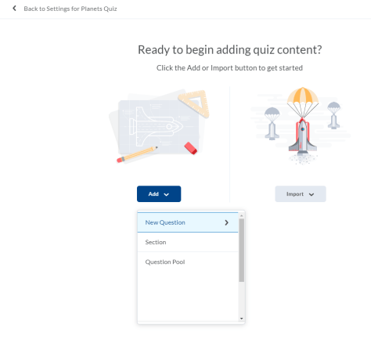
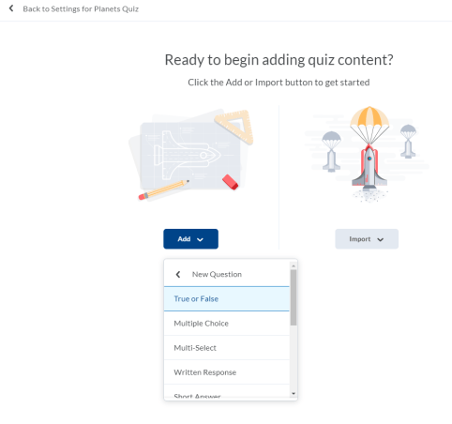
Create a Quiz (3/4)
1
2
Click “Add” and then “New Question”
Choose a quiz question type to get started!
Notes:
This slide can serve as a resource for your educators & staff after the webinar. It can also serve to help with step by steps instructions if doing a live demo is not possible.
Another option is to let your attendees know these how-to slides are in the slide deck for them to reference, and hide the remaining slides during the live webinar, and unhide them prior to send the slide deck to your attendees after the webinar.

Slide 14
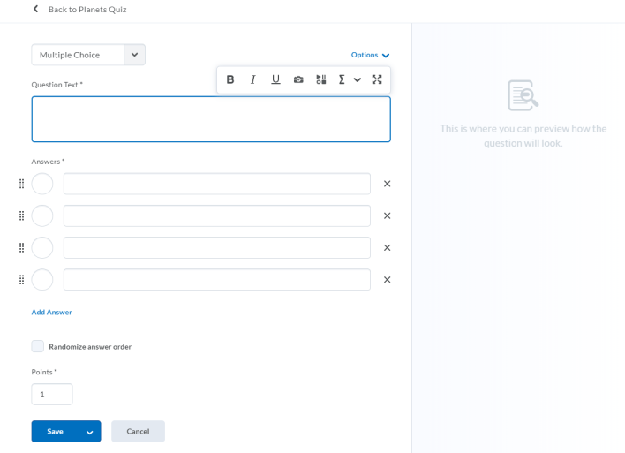
Create a Quiz (4/4)
Check out other options here, such as “Add Hint” or “Add Feedback”
Need a new question type? Change it here!
Add in your question text. Note that you can provide written or multi-media content for students
Fill in the possible answers, designate the correct answer, how many points the question is worth, and if you would like the randomize the answer order for students, if applicable.
If you’re all done, click “Save”. To build more questions, click the down arrow beside “Save.” Save and make a new question with “Save and New,” or click “Save and Copy” to repeat the information in your current question to a new question.
1
2
3
Notes:
This slide can serve as a resource for your educators & staff after the webinar. It can also serve to help with step by steps instructions if doing a live demo is not possible.
Another option is to let your attendees know these how-to slides are in the slide deck for them to reference, and hide the remaining slides during the live webinar, and unhide them prior to send the slide deck to your attendees after the webinar.

Slide 15
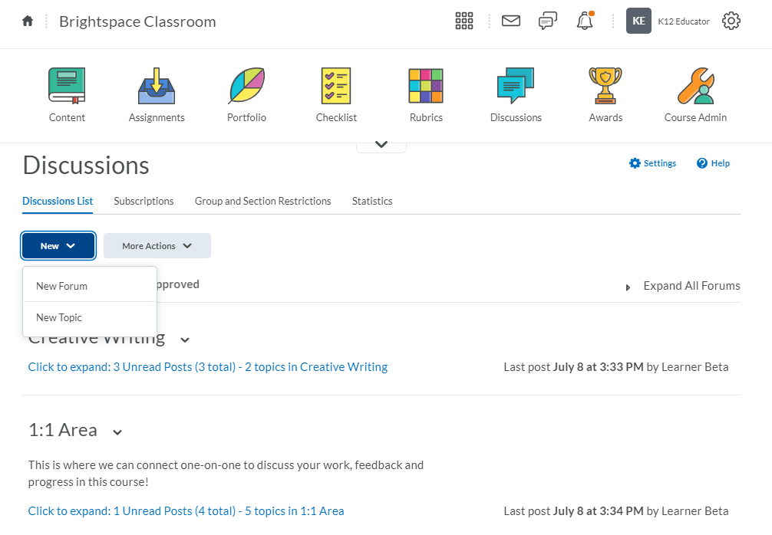
Create a Discussion Forum (1/2)
1
2
Click Discussions from your Navbar or Course Admin tool list
Click the blue “New” button and select “New Forum”
Notes:
This slide can serve as a resource for your educators & staff after the webinar. It can also serve to help with step by steps instructions if doing a live demo is not possible.
Another option is to let your attendees know these how-to slides are in the slide deck for them to reference, and hide the remaining slides during the live webinar, and unhide them prior to send the slide deck to your attendees after the webinar.

Slide 16
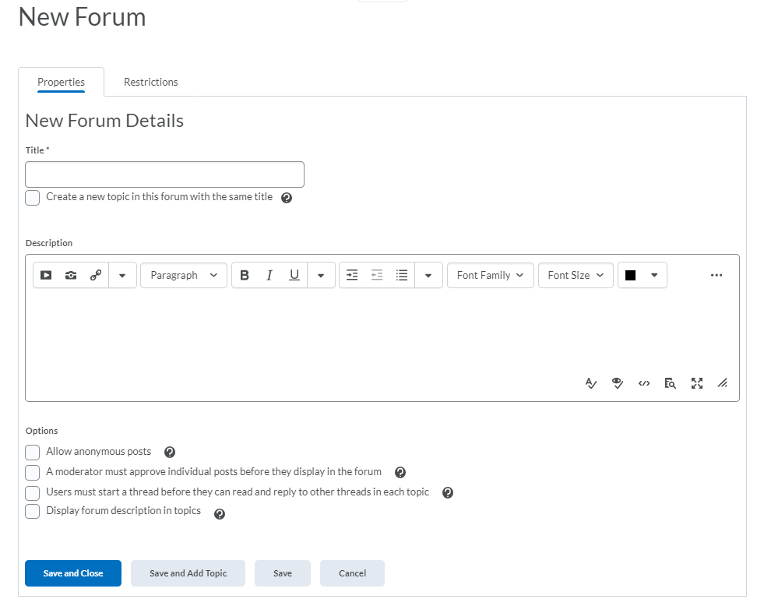
Create a Discussion Forum (2/2)
Use restrictions to add Release Conditions or make this Forum available to certain groups or sections in your course
Give your Forum a title
Provide a description for your forum and configure options for the Forum overall (Tip: These options are also available at the topic level, which will provide more choice and variety for each individual post rather than at the Forum level)
Save and close OR save and add a Discussion Topic!
1
2
3
Notes:
This slide can serve as a resource for your educators & staff after the webinar. It can also serve to help with step by steps instructions if doing a live demo is not possible.
Another option is to let your attendees know these how-to slides are in the slide deck for them to reference, and hide the remaining slides during the live webinar, and unhide them prior to send the slide deck to your attendees after the webinar.

Slide 17
Create a Discussion Topic (1/2)
1
2
Click Discussions from your Navbar or Course Admin tool list
Click the blue “New” button and select “New Topic”
Notes:
This slide can serve as a resource for your educators & staff after the webinar. It can also serve to help with step by steps instructions if doing a live demo is not possible.
Another option is to let your attendees know these how-to slides are in the slide deck for them to reference, and hide the remaining slides during the live webinar, and unhide them prior to send the slide deck to your attendees after the webinar.

Slide 18
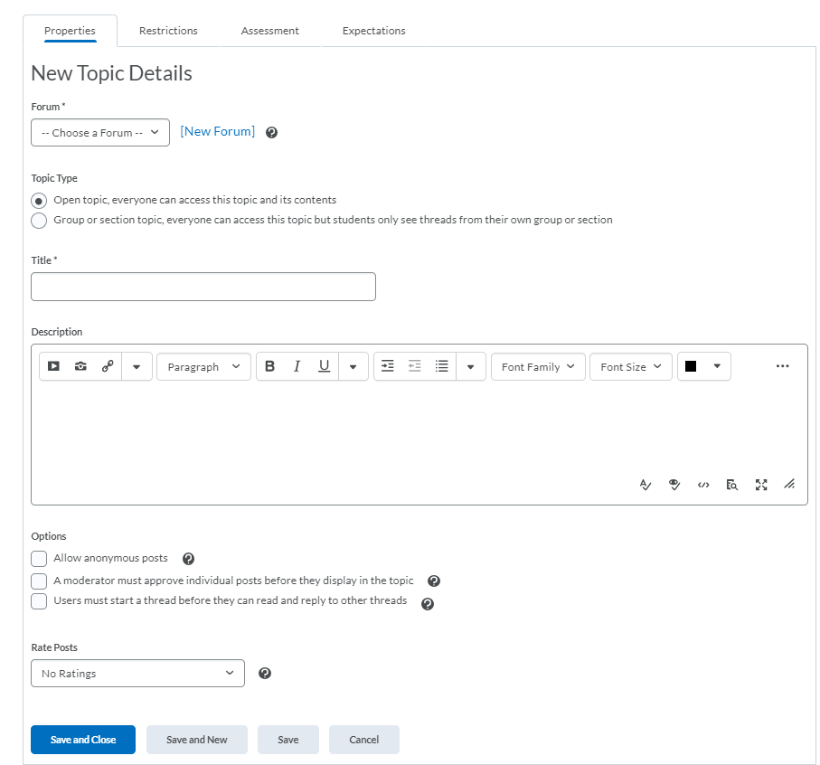
Create a Discussion Topic (2/2)
Use restrictions to add Release Conditions or make this Forum available to certain groups or sections in your course
1
Decide which Forum your Topic will live under
Decide if the Topic will be an Open topic or a Group/section topic
Give your topic a title, content (i.e., instructions, a video, an image etc) and configure your options (if applicable) for this Topic
Save and close or save and create a new Topic!
2
3
4
Notes:
This slide can serve as a resource for your educators & staff after the webinar. It can also serve to help with step by steps instructions if doing a live demo is not possible.
Another option is to let your attendees know these how-to slides are in the slide deck for them to reference, and hide the remaining slides during the live webinar, and unhide them prior to send the slide deck to your attendees after the webinar.

Slide 19
Example Discussion Activities:
Blogs/Vlogs
Book club
Cookbook
Class story writing/ Creative writing
Collaboration/ Group workspace
Journals
News Center (you could highlight news, or students could play reporter on a topic!)
Reviews for TV Shows, Movies and Books!
Subject/topic help areas
Well-being area
Weekly riddle, math problem etc
1:1 Student-Educator discussion area
Notes:
Here are some sample Discussion activities you could try with your students!

Slide 20
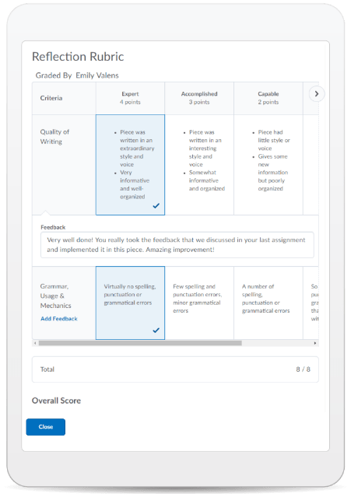
Learning Objectives:
You will be able to:
Create a Quiz
Use Special Access and Release Conditions on Quizzes
Create a Discussion Forum and Topic
Use Release Conditions on a Discussion Forum or Topic
© 2020 D2L Corporation
Notes:
This slide can serve as a resource for your educators & staff after the webinar. It can also serve to help with step by steps instructions if doing a live demo is not possible.
Another option is to let your attendees know these how-to slides are in the slide deck for them to reference, and hide the remaining slides during the live webinar, and unhide them prior to send the slide deck to your attendees after the webinar.

Slide 21
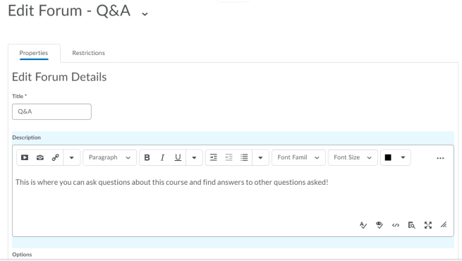
Give This a Try!
Make a quick Exit Ticket in Quizzes!
Create a Q&A Discussion Forum and Topic so that students can ask and respond to questions about your course.
Notes:
Looking on how to get started? Give one of these take away activities a try!

Slide 22
Resources
Brightspace Quick Start Guide K-12
Create a New Discussions Forum
Create a New Discussion Topic
Create a New Quiz
D2L Parent and Guardian Support Site
Discussions- Restricting Access
Quizzes- Attach a Release Condition
Quizzes- Grant a User Special Access
Notes:
This page has resources specifically on Quizzes, Discussions Release Conditions and Special Access. This is also where District specific resources can be added.

Slide 23
Tutorial Videos
Communication and Collaboration | Organizing Course Materials | Documenting Student Learning | Feedback & Assessment
Announcements Activity Feed -Add Attachments and Links to Posts -Create an Assignment Post in Activity Feed -Customize Notifications for Activity Feed -For posting a message -Optimize Activity Feed Discussions | Content/Lessons Tool -Getting Started with Lessons for Instructors -Lessons: Add a New Unit and Lesson -Lessons: Add New Materials -Lessons: Reorder Units, Lessons, Folders, and Materials -Lessons: Attach a Release Condition Groups -Creating Groups -Creating Individual Student Groups -Creating Unique Learner Pathways | Brightspace Portfolio -Review and Approve Portfolio Items -Oversee and View Individual Portfolios -Brightspace Portfolio: Bring Your Own Device (for learners) -Portfolio AT HOME Assignments Discussions Quizzes -Quiz Question Converter | Rubrics -Create an Analytic Rubric -Create a Holistic Rubric Grades -Entering Grades -Associate an Activity with a Grade Item -Create a Grade Scheme Standards/Expectations -Standards: Import Standards from Course Admin Assessing or Evaluating Against Expectations Quick Eval
Notes:
There are also many quick tutorial videos available! These resources are organized pedagogically. Every underlined item is linked to a tutorial video

Slide 24
Thank you!
@Twitterhandle
#districthashtag
#D2LK12
Notes:
Thank you so much for joining us today!
If you have any questions or need any help, please consult or contact:
We’d love to see all the awesome ways you’re using Brightspace! Use our District hashtag and/or #D2LK12 so we can all learn from each other and share great ideas of how to use Brightspace to support teaching, learning and, most importantly, our students!

